Slide 1

The influence of spacecraft latitudinal offset on the accuracy of corotation forecasts
Harriet Turner, Mathew Owens, Matthew Lang and Siegfried Gonzi

Slide 2
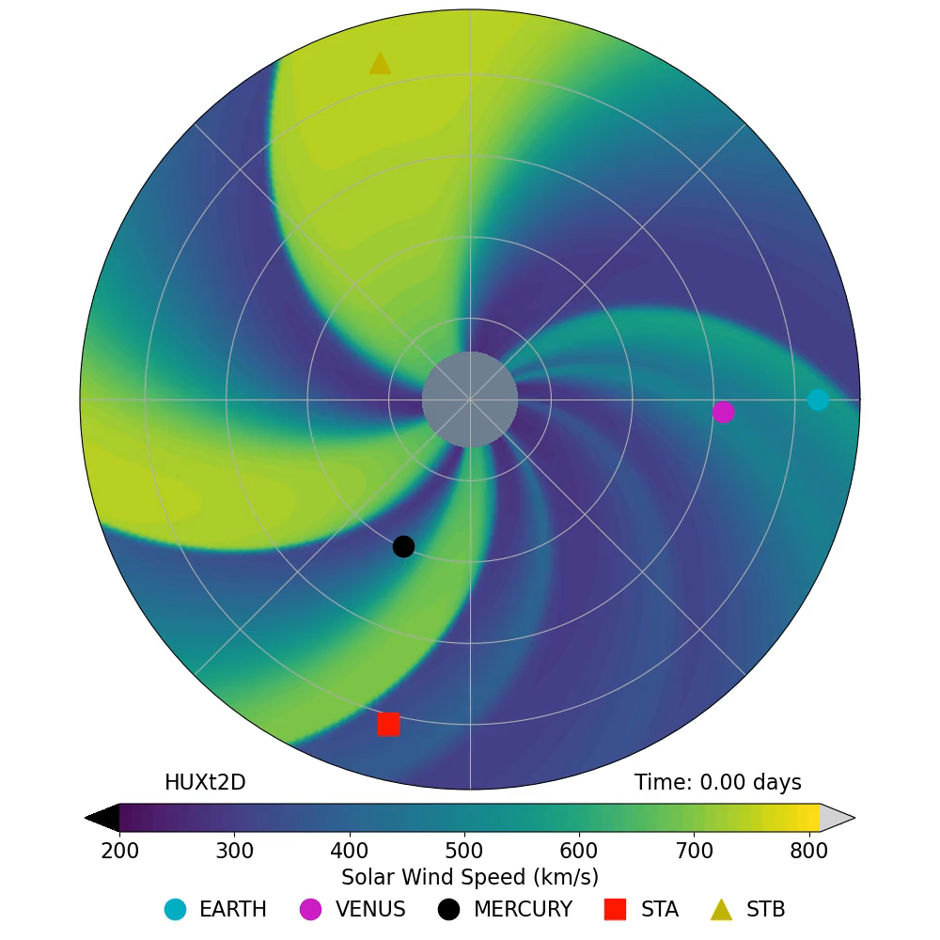
Corotation forecasts
Assumes steady-state solar wind in the reference frame rotating with the Sun
Uses observations on the ecliptic plane
Corotation time determined by longitudinal and radial separation
Notes:
Corotation is a simple-yet-effective method of forecasting solar wind speed near the ecliptic plane. By assuming a steady-state solar wind in the reference frame rotating with the Sun, observations from spacecraft can be used as a forecast for further on in the Sun’s rotation. For example, an observation from STEREO-A in this animation could be time-lagged and used at Earth as a forecast. This time-lag, called ‘corotation time’, is determined by the longitudinal and radial separation of the two points. Consequently, the corotation time is also the forecast lead-time.

Slide 3
Connected variables
Corotation time – longer corotation times makes the steady-state assumption less valid
Solar activity – affects time evolution of the solar wind
Latitudinal offset – two spacecraft observing different solar wind structures
Latitudinal offset
Notes:
A number of variables affect the accuracy of corotation forecasts. The longer the corotation time, the less valid the steady-state assumption is. This is linked to the level of solar activity, as this affects the time evolution of the solar wind. The steady-state assumption is less valid during solar maximum due to the dynamic nature of the solar wind. This is further linked to the latitudinal separation between the two spacecraft, here called latitudinal offset. At solar minimum, there is a strong latitudinal ordering of the solar wind, with a band of slow solar wind located near the Sun’s equator. Therefore, it is expected that latitudinal offset would be more important at solar minimum as the two spacecraft could be in two different solar wind regimes. These variables are all connected and difficult to disentangle.

Slide 4
Motivation – data assimilation
Data assimilation (DA) combines observations and model output to find an optimum estimation of reality
Investigate uncertainties through analysis of corotation forecasts
Model
Assimilation
Observations
Improved model results
Notes:
This work was motivated by its use in improving solar wind data assimilation. DA combines observations and model output to find an optimum estimation of reality and has led to large improvements in terrestrial weather forecasting. It is starting to be used in solar wind forecasting, and through investigation of the errors in corotation forecasts, it is hoped that this can lead to improvements in the data assimilation. Here, we are investigating the error introduced from latitudinal offset. This is a representivity error, where the error arises from poor representation of the observations in the model.

Slide 5
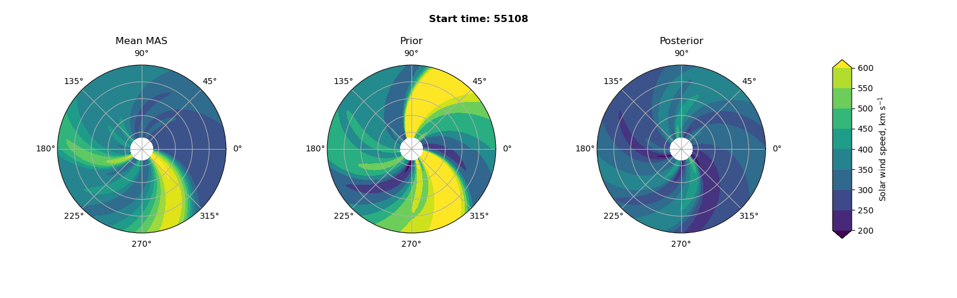
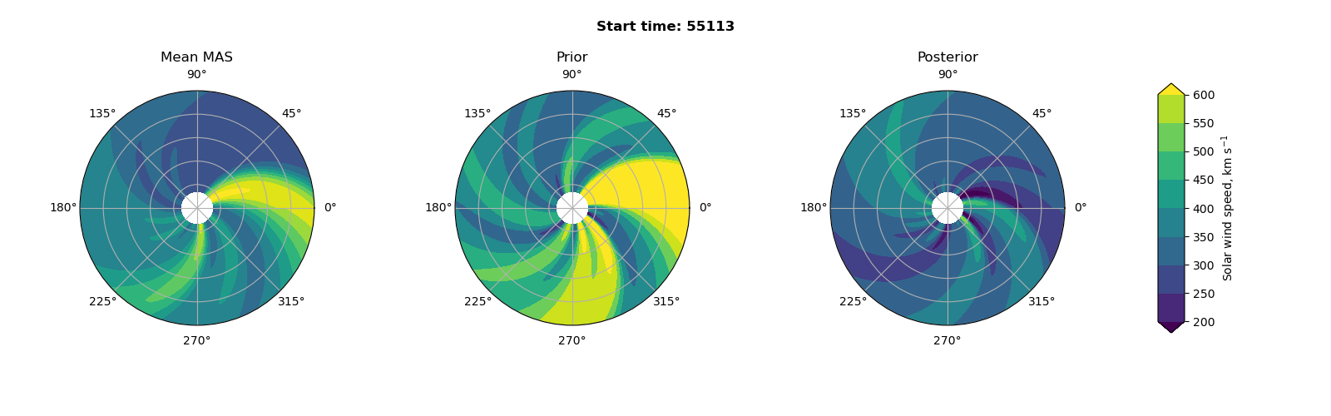
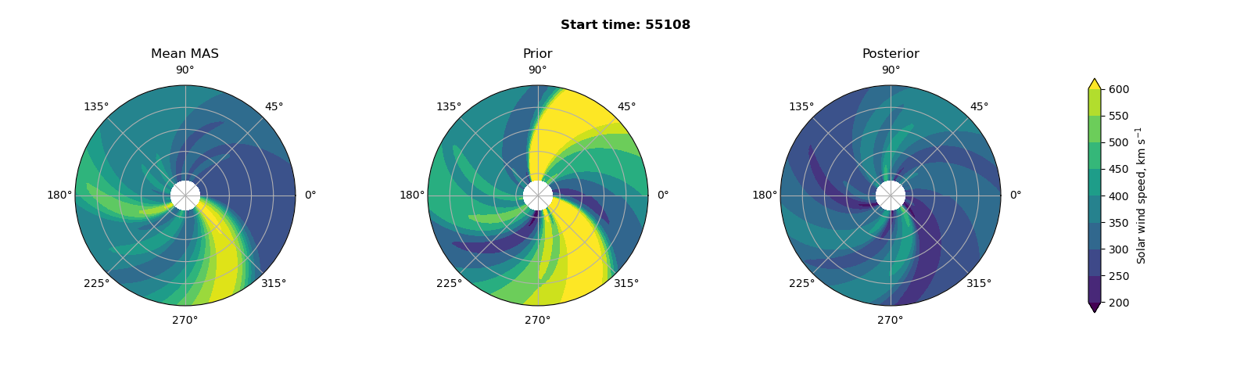
L5 Lagrange point
Mission due for launch in 2027 to provide a side-on view of Earth-directed CMEs
time = t
time = t + 4.5 days
Notes:
This work also has implications for the future L5 space weather monitoring mission due for launch in 2027. Not only can this mission provide a side-on view of Earth-directed CMEs, but it also provides an opportunity for corotation forecasts. The L5 position is 60 degrees behind Earth, which corresponds to a corotation time of around 4.5 days. L5 and Earth reach a maximum of approximately 5 degrees in latitudinal separation. Therefore, investigating the influence of latitudinal offset can allow us to know how accurate a forecast from L5 may be.

Slide 6
Data
Using STEREO mission and OMNI data set
6 possible corotation combinations
Majority of analysis for 2007 – 2014
B
A
OMNI
Notes:
This study uses the twin STEREO mission and the OMNI data set. This provides 6 possible corotation combinations between the spacecraft with the majority of analysis covering the period from 2007 to 2014. This was the lifetime of STEREO-B, and up to the large data gap in the STEREO-A data. There is some analysis covering the period from 2015 to 2019, but this is restricted to the OMNI to STEREO-A and STEREO-A to OMNI corotations.

Slide 7
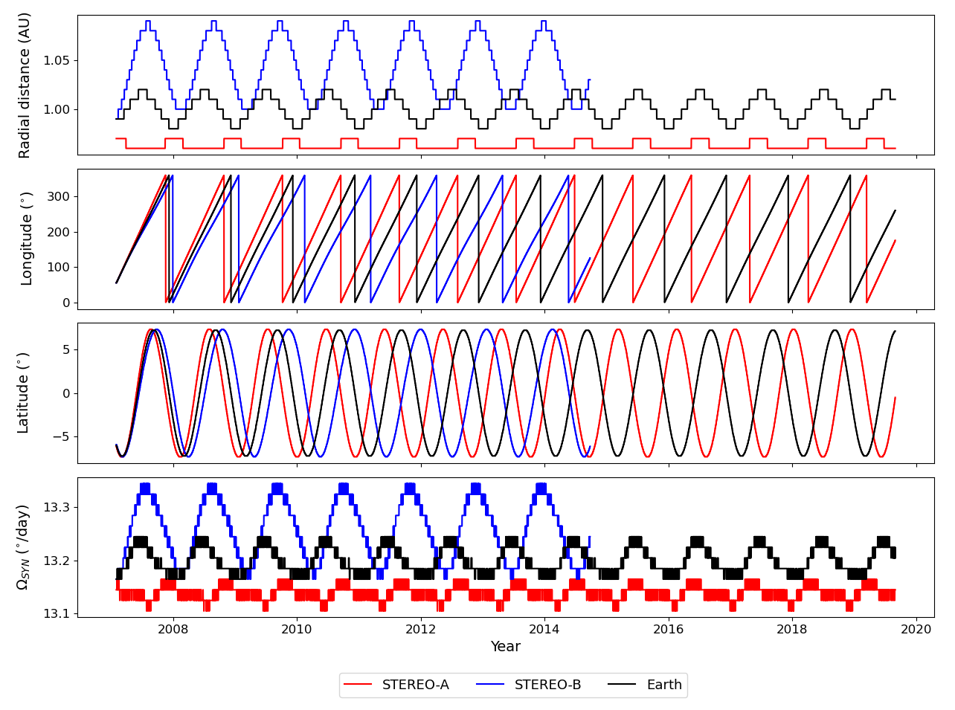
Methodology
Previous methods used only longitudinal and radial separation
Included variation in spacecraft orbital angular speed in the inertial reference frame
Notes:
Previous investigations into corotation forecasts have used only longitudinal and radial separation to calculate the corotation time. Here, we include the variation in spacecraft orbital angular speed in the inertial reference frame, which varies for each spacecraft, as shown in this figure. Corotation time involves two elements, the time it takes for the solar wind to propagate the difference in radial distance and the time to corotate with the Sun from the source spacecraft to the target spacecraft.

Slide 8
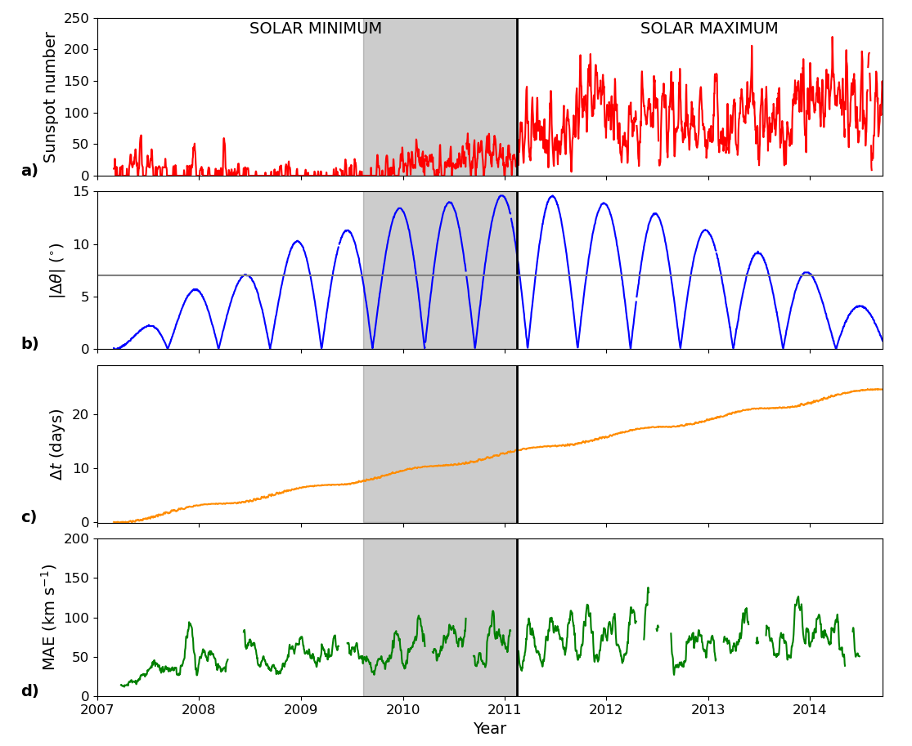
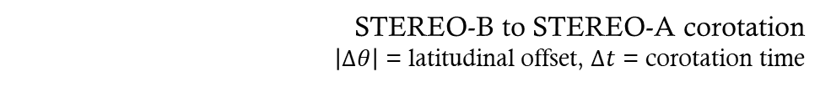
Results
Complications due to variable aliasing (misidentification of a signal)
Low latitudinal offset at times of low corotation time and sunspot number
Difficult to ascribe changes in mean absolute error (MAE) to one variable
STEREO-B to STEREO-A corotation
$\left|∆θ\right|$ = latitudinal offset, $∆t$ = corotation time
Notes:
As mentioned earlier, the interconnected nature of the affected variables has made analysis challenging. There is a lot of aliasing among variables, with a lot of the low latitudinal offset occurring at times with low corotation time and sunspot number. As the maximum latitudinal offset increases, this is the time when both sunspot number and, for this corotation configuration, corotation time increases. Therefore, it is difficult to ascribe changes in mean absolute error to any one variable. Here, this grey shaded region is used for further analysis, which will be discussed later.

Slide 9
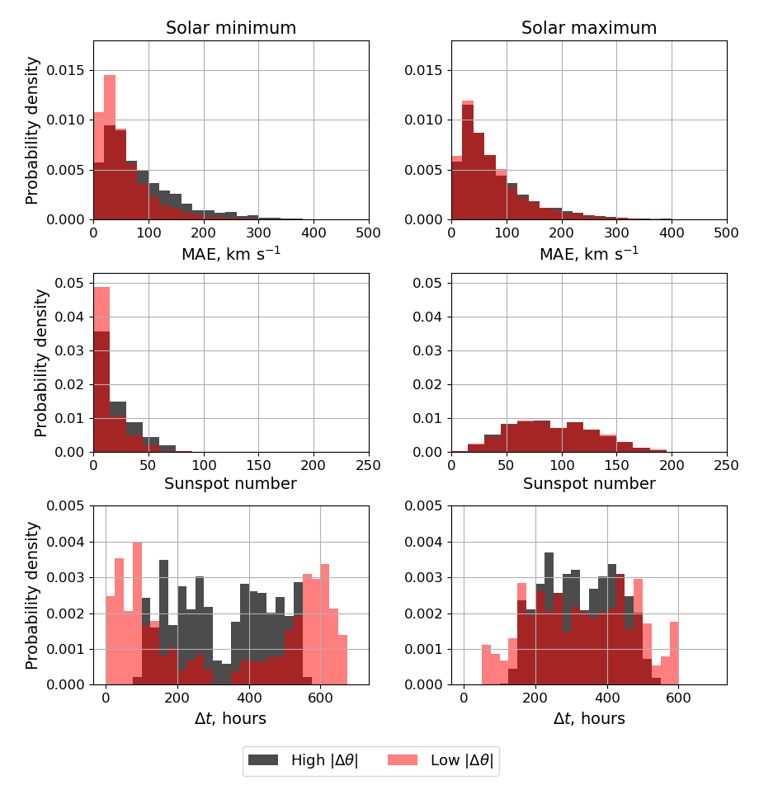
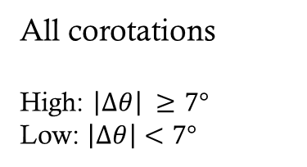
Variable aliasing
All corotations
High: $\left|∆θ\right| ≥7°$
Low: $\left|∆θ\right|<7°$
Notes:
Looking at the distribution of the variables, we can see the aliasing. Here, the data has been divided into high and low latitudinal offset. High latitudinal offset is 7 degrees and above, and low is below 7 degrees. A lot of the low latitudinal separation is concentrated at either low or high corotation time, which is around the beginning of the mission. Therefore, when assessing the relationship between mean absolute error and latitudinal offset, the results are not as they seem.

Slide 10
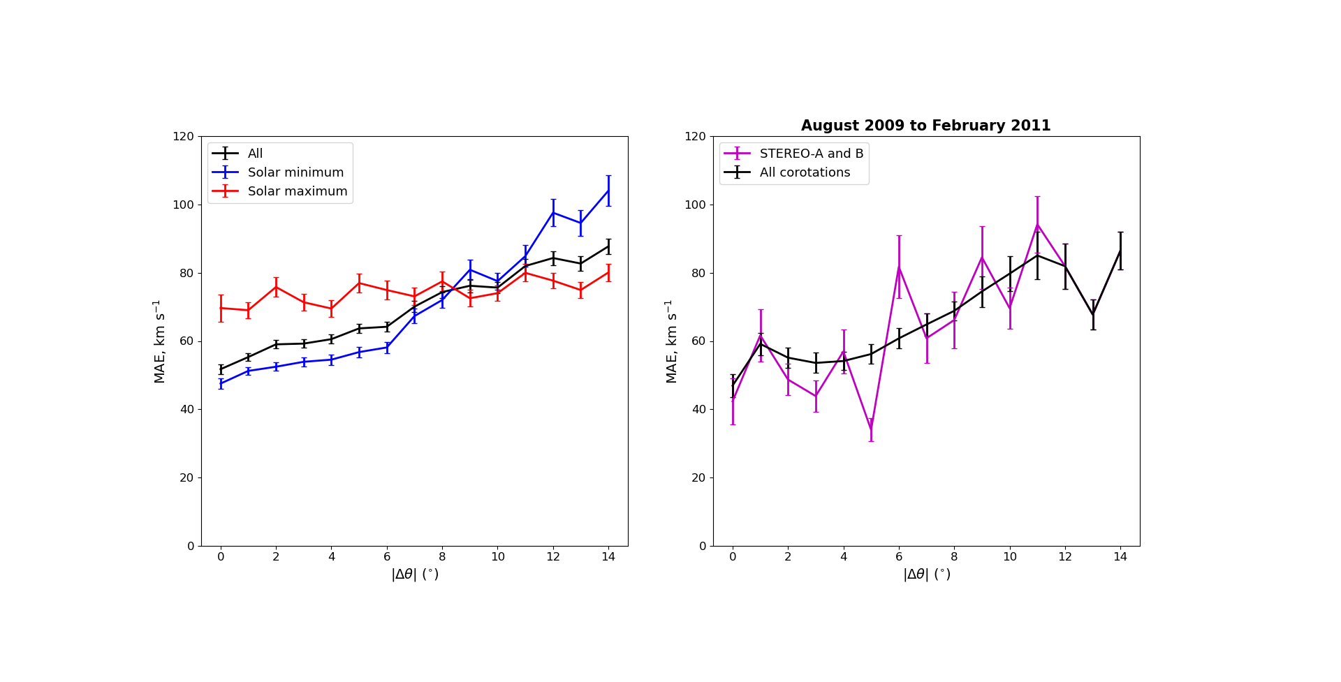
Latitudinal offset with MAE
All corotations
Notes:
The results are as expected, showing an approximately constant error with latitudinal offset for solar maximum and an increasing dependency with latitudinal offset for solar minimum. However, as the histogram showed, a lot of the low latitudinal offset data was at short corotation times and so this reduction in MAE is likely an effect of this.

Slide 11
Restricted period
To limit aliasing, a period of approximately constant sunspot number and even sampling of latitudinal offset at all corotation times was required
Used period from 08/2009 to 02/2011 – time up to the transition from solar minimum to maximum
Isolate latitudinal effect
Notes:
To reduce the effect from variable aliasing, a period of approximately constant sunspot number with even sampling of latitudinal separation and corotation time was required. We use the period from August 2009 to February 2011, which is the time preceding the transition from solar minimum to maximum. This was a time with an approximately constant sunspot number, but latitudinal offset gets to a large enough maximum value.

Slide 12
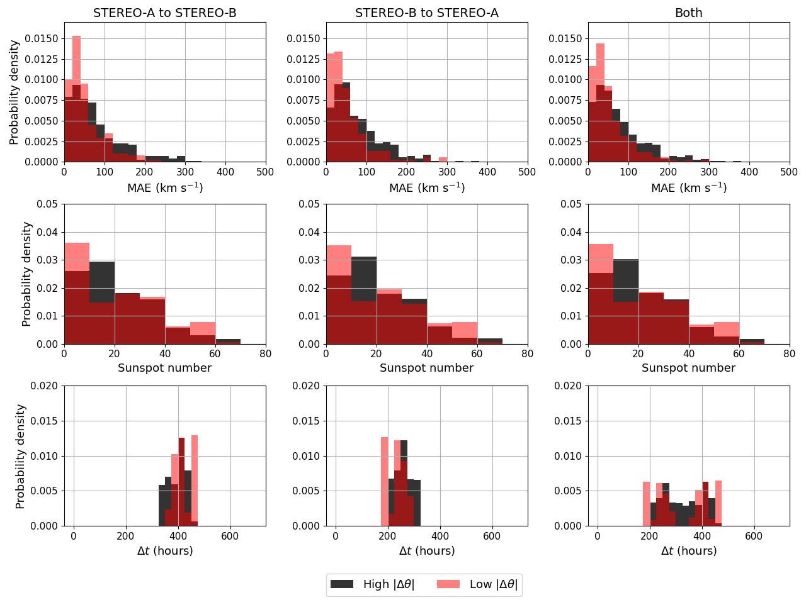
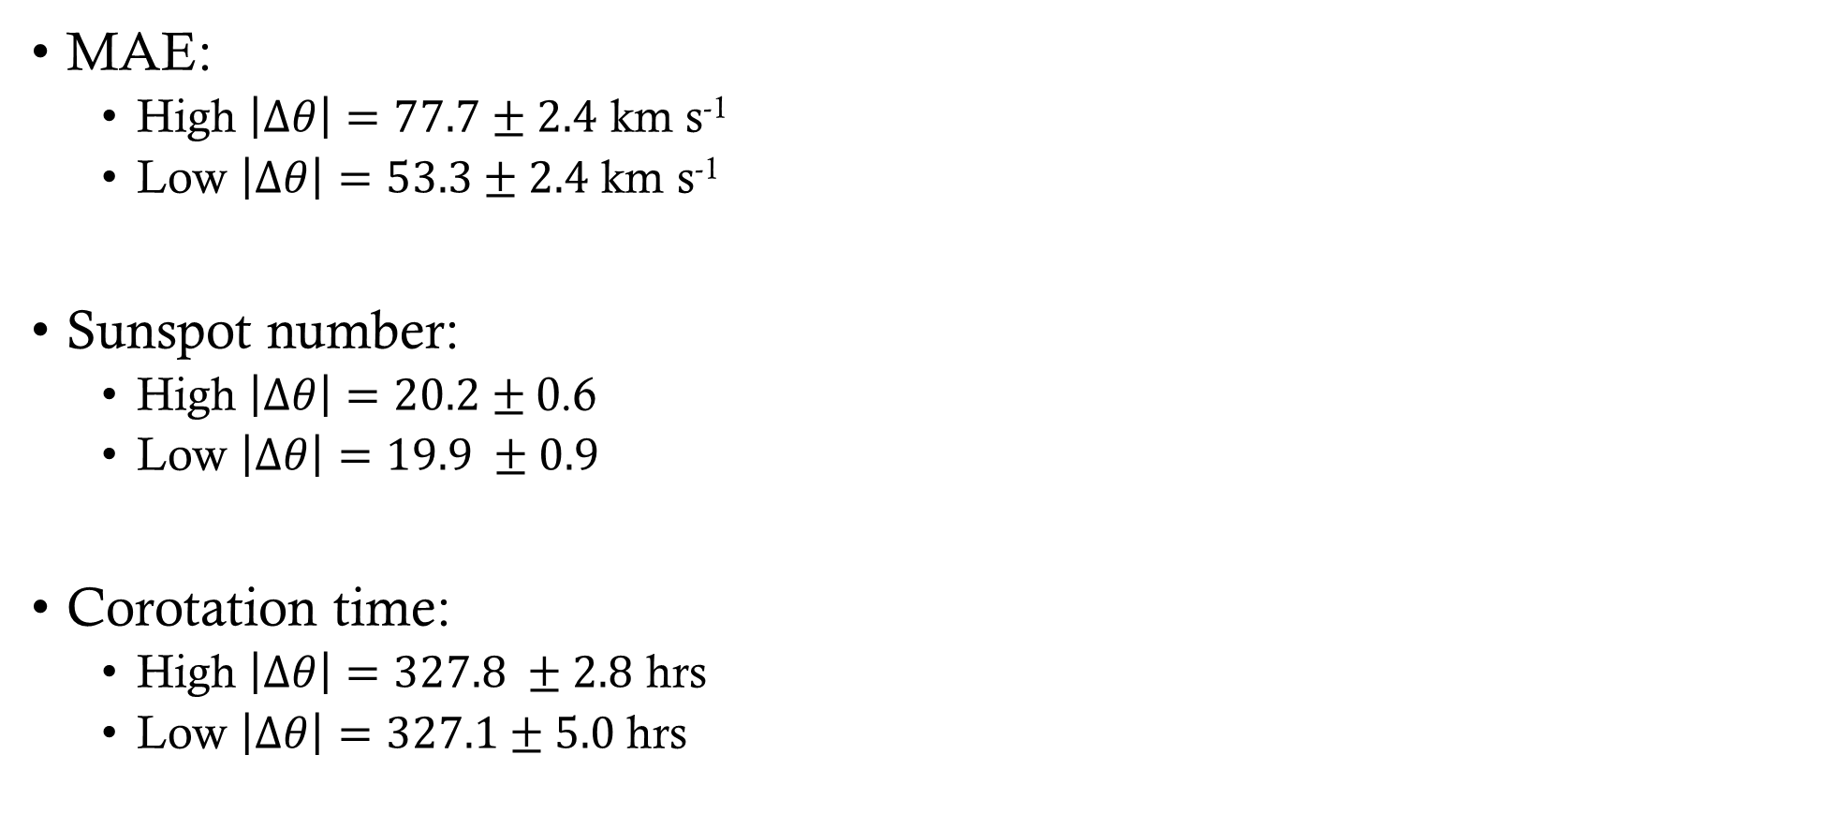
Restricted period
MAE:
High $\left|∆θ\right|=77.7±2.4$ km s⁻¹
Low $\left|∆θ\right|=53.3±2.4$ km s⁻¹
Sunspot number:
High $\left|∆θ\right|=20.2±$0.6
Low $\left|∆θ\right|=19.9 ±0.9$
Corotation time:
High $\left|∆θ\right|=327.8 ±2.8$ hrs
Low $\left|∆θ\right|=327.1±5.0$ hrs
Notes:
Here we can see that there is an approximately even sampling of sunspot number and corotation time between high and low latitudinal offset. There is, however, a difference between the two distributions of MAE, with high latitudinal offset tending towards higher values of MAE. This can be further seen in the mean values for both corotations combined. The sunspot number and corotation time are very similar between high and low latitudinal offset, however there is a distinct difference in the MAE. This shows that high latitudinal offset does have a significant impact on forecast accuracy.

Slide 13
Latitudinal offset with MAE
Notes:
Looking at the MAE versus latitudinal offset graph, we can see that there are two regions. The MAE contribution up to 6 degrees is approximately constant, whereas above this, there is an increasing dependency. This can be seen when using all 6 corotations in black and for the STEREO-A to B and B to A corotations in magenta.

Slide 14
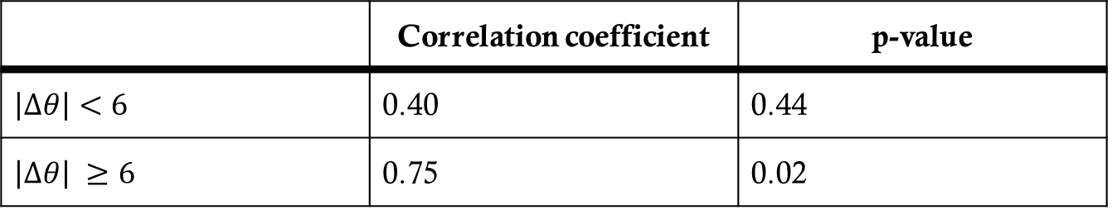
Impact from latitudinal offset
Approximately constant error up to 6º separation
Increasing dependence for > 6º
 | Correlation coefficient | p-value
$$\left|∆θ\right|<6$$ | 0.40 | 0.44
$\left|∆θ\right| ≥6$ | 0.75 | 0.02
Notes:
As we saw in the previous figure, there was an approximately constant contribution up to an offset of 6 degrees, and then an increasing dependency after that. The correlation coefficients and corresponding p-values show that there is a strong and significant relationship between MAE and latitudinal offset above 6 degrees, but below it is insignificant.

Slide 15
Future work
Implement results into the DA scheme
Validate the changes
Look at CME propagation through the improved ambient solar wind
Notes:
In the future, it is hoped that this work can be implemented into the DA to improve its representation of the solar wind. It would involve updating the observation error covariances, whereby observations with a latitudinal offset of less than six degrees would have a constant error contribution, but above this there would be some dependency on latitudinal offset. This can then be validated against observations and, eventually, we will be able to look at how CMEs propagate through the improved solar wind and how their arrival time is affected.

Slide 16
Conclusions
Used STEREO spacecraft and OMNI data set for corotation forecasts
Approximately constant error contribution from latitudinal offset up to 6 degrees, increasing dependency above this
Latitudinal offset should have little effect on L5 corotation
Will be used to improve data assimilation
Work is available pre-print at https://www.essoar.org/doi/abs/10.1002/essoar.10507131.1
Notes:
Here we used STEREO and OMNI data to compute solar wind speed corotation forecasts. It was found that there was an approximately constant error contribution from latitudinal offset up to 6 degrees, but an increasing dependency above this. As the maximum latitudinal separation between L5 and Earth is 5 degrees, it is expected that the error introduced from latitudinal offset should not have a significant impact. This error information will be used to improve solar wind data assimilation as the observations will be better handled.
You can find the work pre-print at this link, I have had an email in the past couple of hours to say the paper has been accepted for publication in Space Weather.

Slide 17
Thank you!
I am happy to answer any questions
h.turner3@pgr.reading.ac.uk

